Slide 1



216U06C105 – Engineering Drawing
Module – I: Projection of planes
Prof. Nidhi Singh
Assistant Professor
Department of Mechanical Engineering
Room – A301
e-mail – nidhi.singh3@somaiya.edu
Mob. No. 9892678850

Slide 2

Projection of Plane Syllabus
Projection of Planes:
Triangular, Square, Rectangular, Pentagonal, Hexagonal and Circular planes inclined to one reference plane only and perpendicular to other.

Slide 3
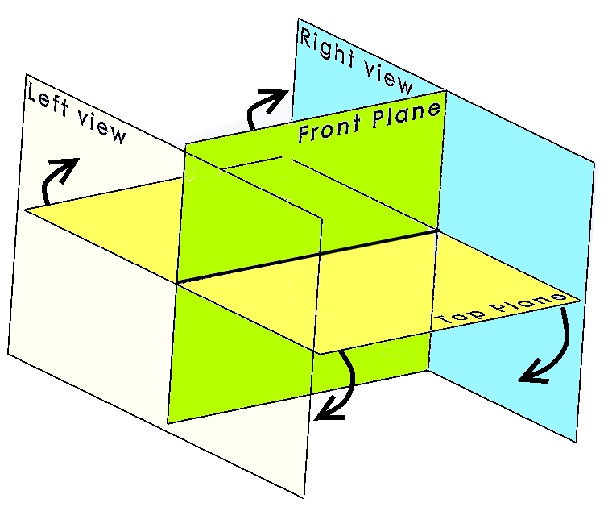
Projection of Planes
Profile Plane
VP
HP
Fig. 1 Projection of points w.r.t. Principal Planes

Slide 4
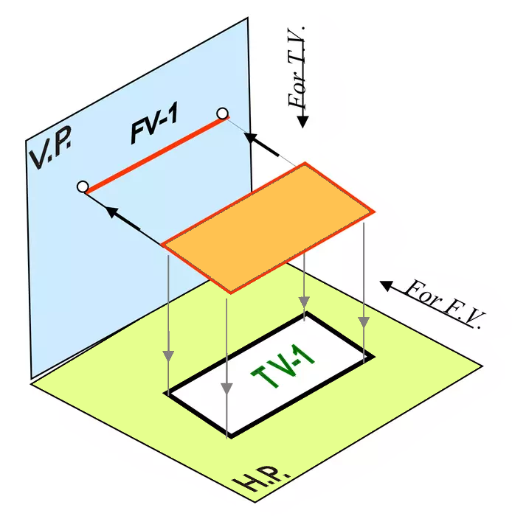
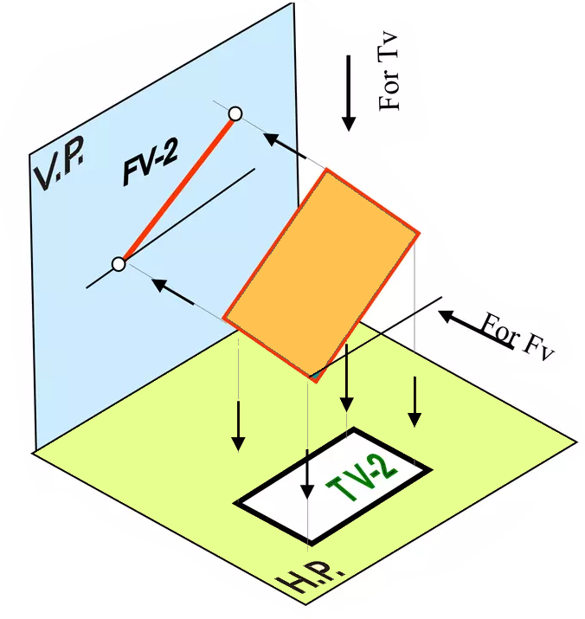
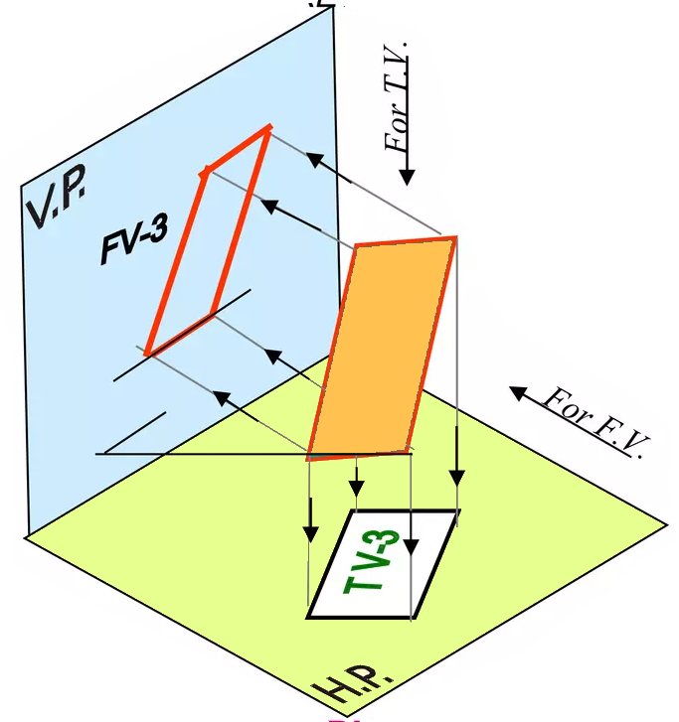
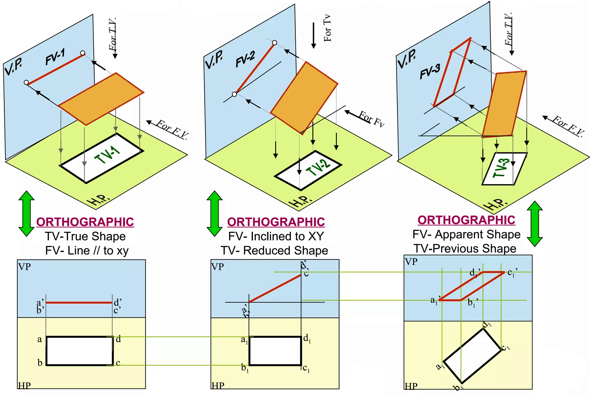
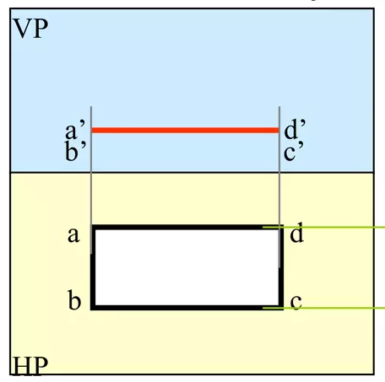
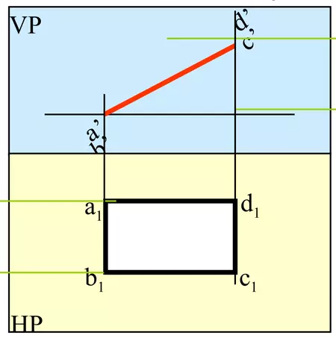
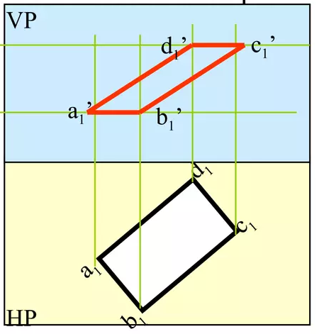
Projection of Plane

Slide 5
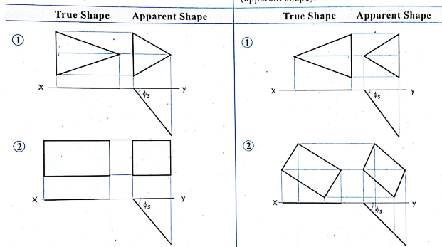

Projection of Lines
Projection of Plane perpendicular to one Principal Plane and inclined to the other
Surface of plane inclined to the V.P. and perpendicular to H.P.
Fig. 2 projections of Triangle, Rectangle ^{[1]}

Slide 6
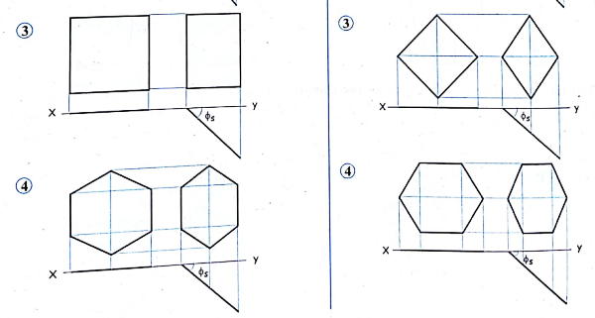
Projection of Lines
Projection of Plane perpendicular to one Principal Plane and inclined to the other
Surface of plane inclined to the V.P. and perpendicular to H.P.
Fig. 3 projections of square, Hexagon ^{[1]}

Slide 7
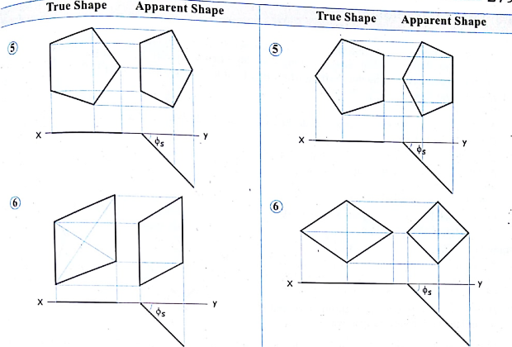
Projection of Lines
Projection of Plane perpendicular to one Principal Plane and inclined to the other
Surface of plane inclined to the V.P. and perpendicular to H.P.
Fig. 4 projections of pentagon, Rhombus ^{[1]}

Slide 8
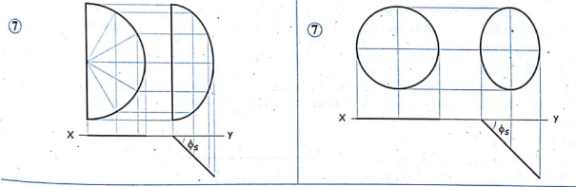
Projection of Lines
Projection of Plane perpendicular to one Principal Plane and inclined to the other
Surface of plane inclined to the V.P. and perpendicular to H.P.
Fig. 5 projections of Semicircle, Circle ^{[1]}

Slide 9
Projection of Planes
Projection of plane with reference to Principal Planes
Surface of plane parallel to one principal planes and Perpendicular to other two
Surface of plane parallel to H.P. and Perpendicular V.P. to Profile plane (P.P.)
Q. 1 A rectangular plane ABCD having length 60 mm and breadth 40 mm is parallel to the H.P. and perpendicular to the V.P. and the P.P. If the plane is 10 mm above the H.P. and one of the longest side (say AD) is 20 mm in front of the V.P. Draw the projections of the plane.

Slide 10
Projection of Planes
Projection of plane with reference to Principal Planes
Surface of plane parallel to one principal planes and Perpendicular to other two
Surface of plane parallel to V.P. and Perpendicular H.P. to Profile plane (P.P.)
Q. 2 A rectangular plane ABCD having length 60 mm and breadth 40 mm is parallel to the V.P. and perpendicular to the H.P. and the P.P. If the plane is 20 mm in front of the V.P. and one of the longer edge side (say BC) is 10 above the H.P. Draw the projections of the plane.

Slide 11
Projection of Planes
Projection of Plane perpendicular to one Principal Plane and inclined to the other
Surface of plane inclined to the H.P. and perpendicular to V.P.
Q. 3 A rectangular plane ABCD having length 70 mm and breadth 40 mm has its surface inclined to the H.P. at an angle 45⁰ and perpendicular to the V.P such that its shorter side AB of a rectangular plane is 10 mm above the H.P. and longer side AD of a rectangular plane is 20 mm in front of the V.P. Draw the projections of the plane.

Slide 12
Projection of Planes
Projection of Plane perpendicular to one Principal Plane and inclined to the other
Surface of plane inclined to the H.P. and perpendicular to V.P.
Q. 4 A square ABCD with sides 40 mm has its surface inclined at an angle 45⁰(θ^{s}) with H.P. and perpendicular to the V.P. such that one of a side of a square plane is in the H.P. Draw its projections.

Slide 13
Projection of Planes
Projection of Plane perpendicular to one Principal Plane and inclined to the other
Surface of plane inclined to the H.P. and perpendicular to V.P.
Q. 5 A square lamina ABCD of 50 mm side rest on the corner A is in the H.P. such that the plane is seen as a rhombus in the top view with diagonal contained by corner A measuring 25 mm. Draw its projections and determine surface inclination of the plane with the H.P.

Slide 14
Projection of Planes
Projection of Plane perpendicular to one Principal Plane and inclined to the other
Surface of plane inclined to the H.P. and perpendicular to V.P.
A rectangular plate 50mm x 70 mm stands on one of its shorter edges in H.P. and is raised about this edge so that the plane becomes a square of 50 mm. Draw the projections of plane and find inclination of the plane with H.P. (Q.1 Booklet)

Slide 15
Projection of Planes
Projection of Plane perpendicular to one Principal Plane and inclined to the other
Surface of plane inclined to the V.P. and perpendicular to H.P.
Q. 6 A hexagonal lamina of side 25 mm is resting in the V.P. on one of its corner. Draw the three view, if the diagonal passing through that corner makes an angle 30⁰ to the V.P. Draw using 1st angle method of projection.

Slide 16
Projection of Planes
Projection of Plane perpendicular to one Principal Plane and inclined to the other
Surface of plane inclined to the H.P. and perpendicular to V.P.
Q. 7 An isosceles triangular plate of 50 mm and 75 altitude appears as and equilateral triangle of 50 mm in top view. Draw the projection of a plate if its 50 mm long edge is on the H.P. What is the inclination of a plate with the H.P.?

Slide 17
Projection of Planes
Projection of Plane perpendicular to one Principal Plane and inclined to the other
Surface of plane inclined to the V.P. and perpendicular to H.P.
Q. 8 A pentagonal plate of 30 mm side has one of its side in the V.P. The corner opposite to the this side contained by the H.P. is 20 mm in front of the V.P. Draw the projections and find the inclination of a surface with the V.P.

Slide 18
Projection of Planes
Projection of Plane perpendicular to one Principal Plane and inclined to the other
Surface of plane inclined to the H.P. and perpendicular to V.P.
Q. 9 A circular plate of 60 mm diameter is resting on point A of its rim with its surface inclined at 30⁰ to the H.P. Draw the projections of the plate.

Slide 19
Projection of Lines
Projection of Plane perpendicular to one Principal Plane and inclined to the other
Surface of plane inclined to the V.P. and perpendicular to H.P.
Fig. 2 projections of Triangle, Rectangle ^{[1]}

Slide 20
Projection of Lines
Projection of Plane perpendicular to one Principal Plane and inclined to the other
Surface of plane inclined to the V.P. and perpendicular to H.P.
Fig. 3 projections of square, Hexagon ^{[1]}

Slide 21
Projection of Lines
Projection of Plane perpendicular to one Principal Plane and inclined to the other
Surface of plane inclined to the V.P. and perpendicular to H.P.
Fig. 4 projections of pentagon, Rhombus ^{[1]}

Slide 22
Projection of Lines
Projection of Plane perpendicular to one Principal Plane and inclined to the other
Surface of plane inclined to the V.P. and perpendicular to H.P.
Fig. 5 projections of Semicircle, Circle ^{[1]}

Slide 23

References
[1] Engineering Drawing, N. H. Dubey

Slide 24
Thank you !!

